Slide 1
Aktorik und Sensorik mit intelligenten Materialsystemen 2
Final Exam B:
Design and Simulaton of a Vibratory System Driven by DE Membrane Actuators
Stefan Seelecke
Gianluca Rizzello
stefan.seelecke@imsl.uni-saarland.de
gianluca.rizzello@imsl.uni-saarland.de Saarland University

Slide 2
ASIM 2 Final Exam
GOAL: design and simulate a stack of DE strip actuators which are used to activate a vibratory actuator
Consider a model describing a DE strip actuator, implemented via files Parameter.m, sDE_dispIn.m, and DEA_strip.slx.
A stack of N DEs, connected in parallel both electrically and mechanically, is considered. NOTE: force and strain are considered along direction 1.
All material and initial geometrical parameters are contained in Parameter.m
F₁
ΔL₁

Slide 3
ASIM 2 Final Exam
A stack of DE membranes is used to drive a 2-degrees of freedom vibratory system
F_{e}
Variables and parameters:
y₁ = upper plate position with respect to fixed reference
y₂ = lower plate position with respect to fixed reference
F_{e} = external force
m₁ = upper plate mass
m₂ = lower plate mass
k₁ = main elastic element stiffness
k₂ = ground connection stiffness
m₁
y₁
k₁
DE
m₂
y₂
k₂
y = 0

Slide 4
ASIM 2 Final Exam
Dynamic model of the system
Overall model block diagram
Known system parameters:
m₁ = 0.25 kg
m₂ = 0.25 kg
k₁ = 10800 N/m
k₂ = 43200 N/m
g = 9.807 m/s²
Known DE parameters:
L₁ = 0.01 m
L₂ = 0.2 m
L₃ = 50 μm
N = 8
F_{e}
Mechanical
system
l₁
F_{DE}
v
DE

Slide 5
ASIM 2 Final Exam
Assume F_{e} = 0. Consider the resulting model equations at steady-state By assuming that the DE can deform only from 0 to 100 % of strain ε₁, and considering the parameter values provided in the previous slide, use the graphical method to design y_{s0} in order to maximize the stroke of the actuator. HINT: solve the quasi-static equations for y₂. Subsequently, use Simulink to control l₁ in such a way that the membrane deformation ranges from 0 to 100% of strain ε₁ at low frequency (e.g., 0.001 Hz). Repeat the quasi-static characterization at both 0 V and 2500 V. Then, use the known value of y₂ to eliminate it from one of the two quasi-static equations, and use it to plot and compare F_{DE} and the bias force as functions of y₁. When generating the force equilibrium plot, use known relationships to relate the calculated values of l₁ and y₂ to y₁, and use the resulting l₁ as array for the x-axis.

Slide 6
ASIM 2 Final Exam
Implement the complete dynamic model in Simulink. Show the system response in terms of time evolution of y₁ and y₂ after the application of a voltage step from 0 V to 2500 V. Make sure that the system is at equilibrium before applying the step.
Find the actuator resonances and anti-resonance by applying a sinesweep (known as chirp in Simulink) ranging from 0 V to 2500 V within a proper frequency range. Plot the response in terms of y₁ and y₂, showing the results both in time and frequency domain.
Repeat 3) by applying instead the square-rooted version of a sinesweep, always ranging from 0 V to 2500 V Comment the differences among the two cases.
By using the non square-rooted sinesweep signal, study the effects of parameters m₂ and k₂ on the system response (both time and frequency domains) by changing them from their nominal values. Consider both larger and smaller values for both parameters.

Slide 7
ASIM 2 Final Exam
Consider nominal values for k₂ and m₂. Find the system resonance frequency corresponding to maximum stroke, and drive the system with a periodic voltage signal ranging from 0 V to 2500 V having as frequency the system resonance. Consider four different types of signals: - Signal 1: sine wave - Signal 2: square wave with duty cycle of 50 % - Signal 3: saw tooth - Signal 4: triangle wave For each signal, show time response of y₁, and compute the resulting peak-to-peak stroke for y₁ and the mean power consumption, defined as follows
Assume now that spring k₁ is replaced with an unstable spring, characterized by a negative stiffness value. By keeping the same DE geometry and system parameters, use the graphical method to redesign k₁ and y_{s0} in such a way to maximize the system stroke. Then, evaluate the system resonances and anti-resonance with the sinesweep test, and compare the results with the ones in 4).

Slide 8
ASIM 2 Final Exam
Consider once again the design with the stable k₁, as in 2). We now assume that the overall system is driven in generator mode. In this case, we consider a nonzero, periodic F_{e} which is acting on the overall actuator. Find constant values of F_{e,min} and F_{e,max} such that, when the membrane is not actuated (v = 0 V), the corresponding DE strain is equal to 10% and 90%, respectively (NOTE: F_{e,min} or F_{e,max} can either be positive or negative values, implying a tension/compression respectively). Then, apply a F_{e} signal corresponding to a square wave with 50% duty cycle, ranging from F_{e,min} to F_{e,max}, and low-pass filtered with a first order filter. Assume a signal period of 1 s, and a low-pass filter with a cut-off frequency of 40 rad/s. Then, apply a voltage signal ranging from 0 V to 2500 V, consisting of a low-pass filtered square wave with 50% duty cycle. Also for the voltage square wave, assume a period of 1 s, and a low-pass filter with a cut-off frequency of 40 rad/s. Adjust the phase of the voltage signal in such a way it is delayed by 25% of period with respect to the force signal, i.e., the membrane is charged at a high capacitance state and then discharged at a low capacitance state.

Slide 9
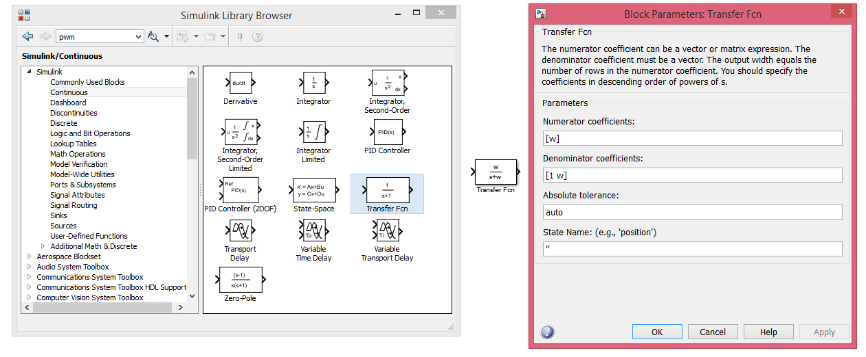
ASIM 2 Final Exam
To implement a low-pass filter with cut-off frequency w (in rad/s), you can use the transfer function block

Slide 10
ASIM 2 Final Exam
Perform a first simulation for many generation cycles, long enough to let all the transients settle down. Plot the resulting time response of mean output power
and energy conversion efficiency (i.e., ratio between output electrical energy of the DE membrane and input mechanical energy due to force F_{e}) Perform also a second generation cycle simulation by considering, instead, both force and voltage signals having a period of 4 s, and low-pass filtered with a cut-off frequency of 10 rad/s. Amplitudes of both force and voltage are the same as before. Compute the resulting P_{o} and η. Compare the performance with respect to the previous case, and comment differences. NOTE: a generated power has a negative sign, while an absorbed power has a positive sign.

Slide 11
ASIM 2 Final Exam
Results must be presented with a presentation done in PowerPoint (or any similar software), in either german or english, which includes plot of the most significant quantities and comments on the results.
Results can be presented by groups of 3 people (or 2, if needed).
For each group, 15 minutes presentation + 15 minutes for questions.
FINAL EXAM B DATE: 27/07/2018, at 13:30 in ZeMA

